Slide 1


THE PROGRAMMATIC AUDIENCE COMPANY
PROGRAMMATICALLY
INTELLIGENT
Confidential and proprietary. Copyright © 2016 Xaxis Inc. All rights reserved. Distribution without permission is prohibited.

Slide 2

THE PROGRAMMATIC
AUDIENCE COMPANY
USING DATA AND TECHNOLOGY TO HELP BRANDS ENGAGE WITH AUDIENCES AT SCALE

Slide 3
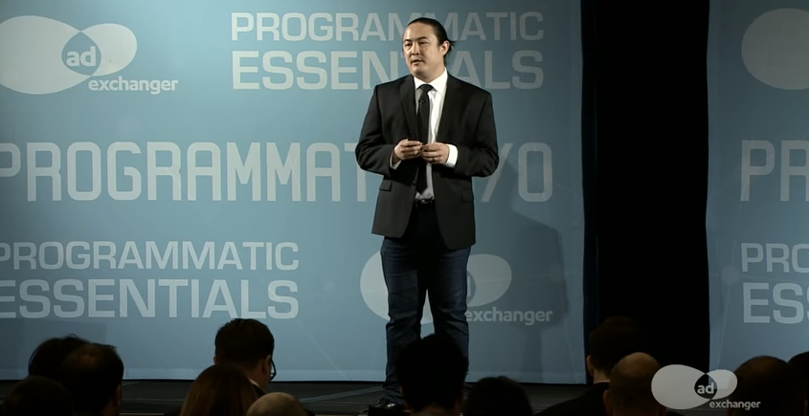

“Why are there still people in this industry that don’t believe that programmatic is anything but the single biggest fundamental shift to happen in marketing over the past 25 years?”
Richard Joyce, Senior Analyst, Forrester Research, Inc.

Slide 4
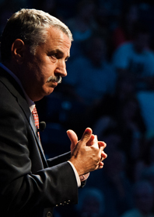

"When the world is flat, you can innovate without having to emigrate".
“One of the iron rules of the world – the world of business, education and entrepreneurship that immediately flows from this new flat world platform – is this: What can be done, will be done.”
The only one question for you, Will it be done by you or to you?
THOMAS FRIEDMAN
Page
4

Slide 5


We are on a mission this year. We are and have always been an audience-first media activation company. In a walled garden (Facebook, Google, etc.), they can’t use data beyond their platforms. We ingest and enhance clients’ customer data and then amplify it across different platforms, across devices, over 300 billion impressions daily regardless of the DSP.
Our goal is to establish our client’s proprietary audiences as the world’s standard currency to activate all media – to make the world flat..
OUR VISION
FLATTENING THE WORLD OF PROGRAMMATIC MEDIA
BRIAN GLEASON, GLOBAL CEO, XAXIS
Page
5

Slide 6
XAXIS: THE PROGRAMMATIC AUDIENCE COMPANY
THE SIX ELEMENTS OF XAXIS SCALE
TALENT
PROPRIETARY AUDIENCE
OVER 1,500 PROGRAMMATIC EXPERTS
PROCESS OVER 10 BILLION USER PROFILES ENHANCED BY 650+ DATA PARTNERS
ADDRESSABLE MEDIA
MARKET COVERAGE
ESTABLISHED IN 46 MARKETS WITH NEARLY 90% OF THE WORLD”S PROGRAMMATIC AD SPEND
ACCESS OVER 600 BILLION IMPRESSIONS DAILY
SMART DATA & ANALYTICS
TECHNOLOGY INFRASTRUCTURE
UPDATE OVER 22,000 SEGMENTS IN REAL-TIME ACROSS OVER 11 DSPS
INVEST OVER $54 MILLION THIS YEAR
Page
6

Slide 7

GLOBAL 1,500 employees in 46 markets
GROWING $1 billion net sales in 2015
EXPERIENCE
3,000 clients
TECHNOLOGY
$54 million
invested in technology just
In 2016
SCALE
300
billion ad impressions
daily
NORTH AMERICA
Canada
USA
EUROPE, MIDDLE EAST
& AFRICA
Norway
Sweden
Netherlands
UK
Denmark
Austria
Belgium
Germany
Italy
Slovakia
Spain
Poland
Portugal
Switzerland
Turkey
Czech Rep
Finland
Romania
Russia
United Arab Emirates
Saudi Arabia
Egypt
ASIA AND PACIFIC
China
Hong Kong
India
Vietnam
Thailand
Malaysia
Singapore
Australia
New Zealand
Taiwan
Indonesia
Philippines
Japan
South Korea
London
EMEA HQ & Delivery Hub
New York
North America HQ & Delivery Hub
Miami
LATAM HQ & Delivery Hub
Singapore
APAC HQ & Delivery Hub
LATIN AMERICA
Mexico
Miami
Brazil
Colombia
Argentina
Puerto Rico

Slide 8


XAXIS: THE PROGRAMMATIC AUDIENCE COMPANY
XAXIS CORPORATE STRUCTURE
SERVICE
STRATEGY
CREATIVE
ANALYTICS
OPTIMIZATION
PRODUCT
AUDIENCE
ENGAGEMENT
OUTCOME
PLATFORM
TURBINE
ACTIONX
XANADU
SPOTLIGHT
QMP
CO-PILOT
BRIGHT
PLISTA
Page
8

Slide 9










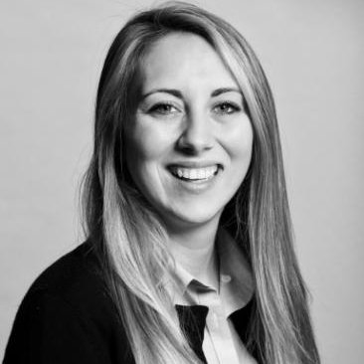





THE PEOPLE OF PROGRAMMATIC MARKETING
OUR EXPERT-TO-EXPERT PROGRAMMATIC SERVICES
STRATEGY
Tailor-made marketing strategy based on advanced analytical models to better enhance media buying and to understand audiences across platforms
CREATIVE
Xaxis AdLabs, our full-service in-house creative team comprised of creatives, developers, animators, and advertising specialists, provides customer experiences that can be wired directly into the Xaxis DMP
ANALYTICS
Our analytics team delivers detailed customer intelligence that will help you connect and understand what consumers are doing now and what they will do next.
OPTIMIZATION
Access our in-house trading experts and our dedicated account teams equipped with proprietary programmatic audience and campaign optimization tools.
Notes:
PHOTO – AND SMART DESCRIPTION
Ad Labs
Analytics
Bagwell
RJ/Damien
Sarah Warner
Max Jaffe
Brianna
Anthony

Slide 10

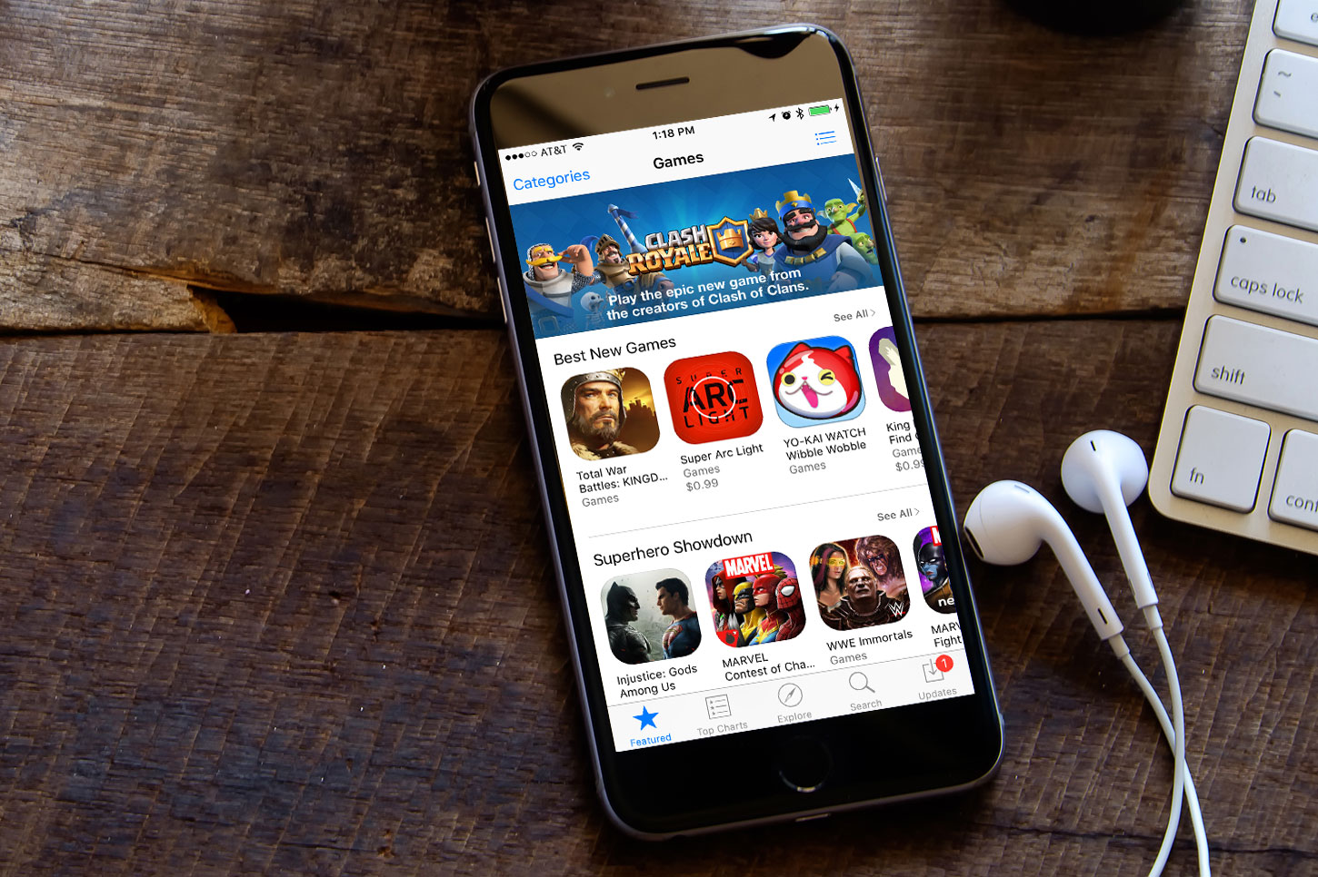

2016 XAXIS PROGRAMMATIC BRANDS
ALIGN PROGRAMMATIC ECOSYSTEMS WITH OUR CUSTOMER’S GOALS
AUDIENCE
ENGAGEMENT
OUTCOMES
Page
10

Slide 11

“Xaxis’ strategy is to build its own technology that gives its clients a competitive edge, and partner for features that are more commoditized.
Every acquisition we’ve made is consistent with that. Another advantage of owning the technology is having complete control over it – important for a data business like Xaxis. This was one of the reasons the company spent $25 million building a DMP, which isn’t licensed and is meant only for Xaxis and its clients, rather than using one of the multiple third-party options in the market.”
.
XAXIS TECH STACK
PROPRIETARY TECHNOLOGY INVESTMENT
NICOLLE PANGIS, GLOBAL COO, XAXIS

Slide 12
2016 XAXIS TECH STACK
XAXIS PROPRIETARY TECHNOLOGY PLATFORMS
TURBINE
SPOTLIGHT
ACTIONX
XANADU
QMP
CO-PILOT
BRIGHT
PLISTA
First of its kind data management platform designed for programmatic speed, centralized planning and audience activation
Data visualization
& analytic dashboard for centralized campaign insights
Mobile-First
media intelligence
& decision engine
for in-app consumer acquisitions
Data and analytics
platform designed for online/offline customer data integration and analysis of historical campaign intelligence
A holistic performance marketing platform that provides cross-channel optimization, tracking, analytics, attribution and ad serving all in one UI and work flow
Artificial Intelligence for KPI-centered campaign optimization with real-time audience,
publisher, media data
Real-time optimization, visualization platform designed to manage specific and granular campaign performance
User-level content recommendation and delivery platform designed specifically for programmatic native environments
Page
12

Slide 13


THE INDUSTRY’S FIRST DMP IS NOW THE NEXT GENERATION AUDIENCE ACTIVATION PLATFORM
2016 XAXIS TURBINE CAPABILITIES
AUDIENCE PLANNING & CREATION BRIDGING PHYSICAL AND DIGTAL WORLDS AND CUSTOMIZED PLANNING FOR YOUR BRAND
MEDIA ACTIVATION
BORDERLESS AND ADDRESSABLE MEDIA BUYING AT PROGRAMMATIC SPEED
PERSONALIZATION
MAKING ADVERTISING WELCOME
INSIGHT CONTINUUM
A CLOSED LOOP MEASUREMENT TO IMPROVE AUDIENCE & CAMPAIGN PERFORMANCE
TURBINE’S MISSION: DEVELOPING THE PROPRIETARY AUDIENCES FOR OUR CUSTOMERS THAT OUTFORM OTHER AUDIENCES IN THE MARKET
Page
13

Slide 14

WHAT IS UNIQUE ABOUT TURBINE?
THE TURBINE DIFFERENCE
FIRST OF ITS KIND DATA PLATFORM
IDENTITY MANAGEMENT
Turbine’s X-ID equips Xaxis to understand anonymous user identities across their devices
DATA FUSION
Enabling us to fuse together audience attributes observed across a user’s devices for a complete view of the consumer
DATA CREATION
Full suite of segmentation capabilities supports custom tailored audience segmentation built for each advertiser
AUDIENCE ACTIVATION
Xaxis can target its audiences across channels, devices, and inventory sources where others cannot, including Walled Gardens
Processes over 50,000 data points in less than 1 second; over one trillion events annually pushing segments to a DSP for media decisions in less than 5 seconds.

Slide 15
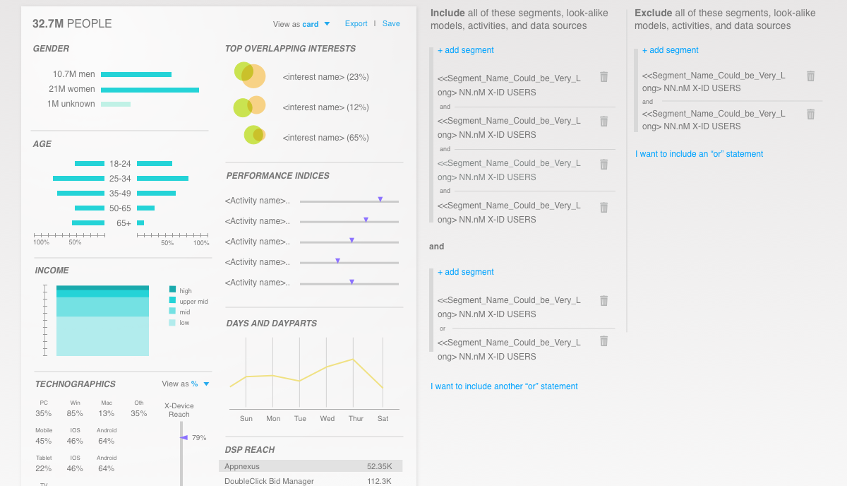
PROGRAMMATIC INTELLIGENCE
xaxis.turbine.com
TURBINE IN ACTION
Next Generation Segmentation Suite Predicts Future Behavior. Turbine segmentation has been validated by comScore.
+
+
AUDIENCE DISCOVERY
MOBILE INTELLIGENCE
+
BID STREAM LEARNING
+
GEOSPATIAL ANALYSIS

Slide 16
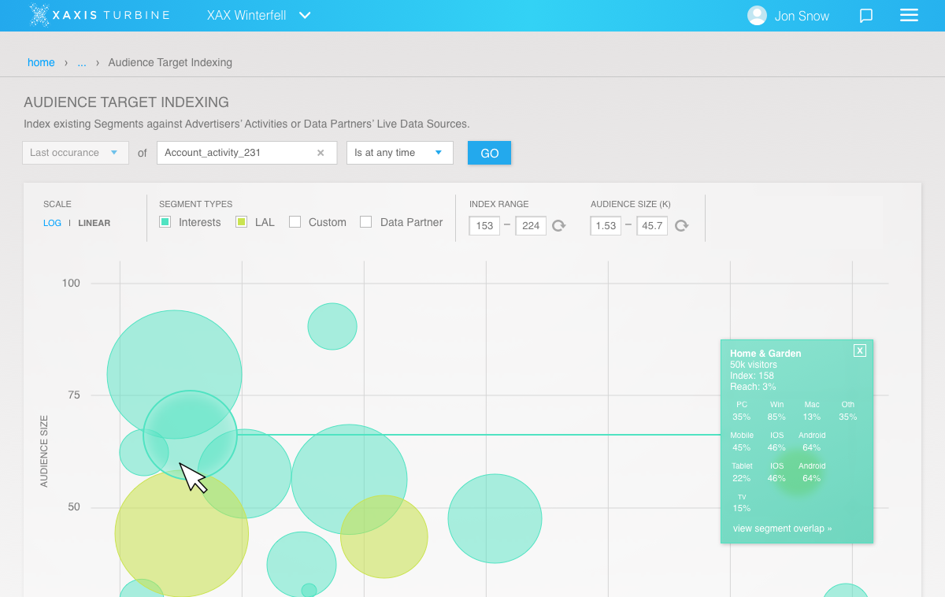

WHAT DOES IT MEAN TO OUR CUSTOMERS?
COMSCORE-VALIDATED TURBINE AUDIENCES
1,104 Behavioral segments arm advertisers to understand what consumers are doing now, and what they will do next
50,000 learnable events per second inform real-time segment membership updates
Taxonomy includes observed Interest, Predicted Interest, and Predicted Intent
Segments include Propensity and Confidence levels for enhanced planning & optimization
Global comScore segmentation audit provides 3rd party validation of Turbine’s predictive power

Slide 17
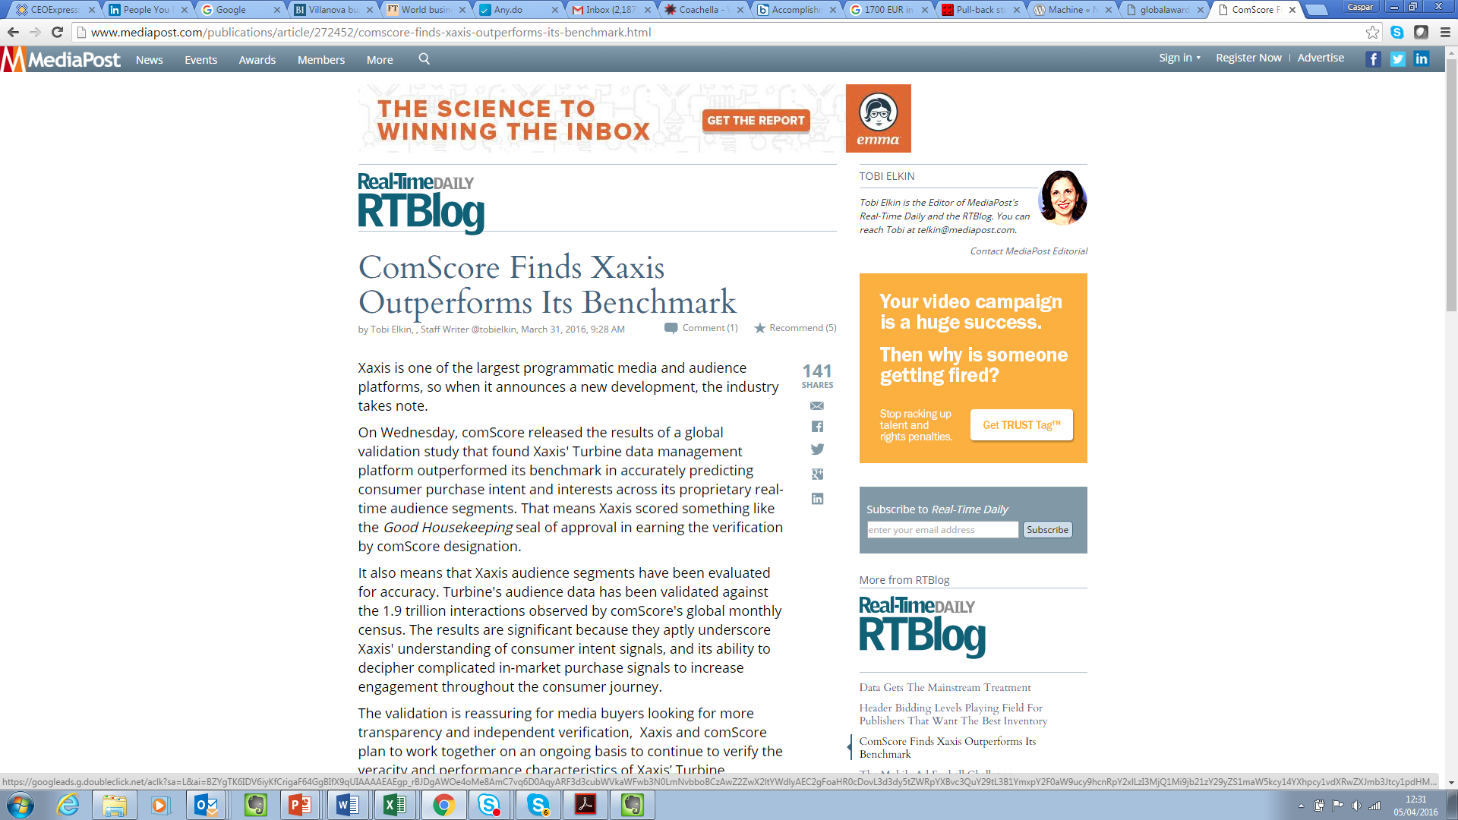
Page
17

Slide 18

… the results are significant because they underscore Xaxis' understanding of consumer intent signals, and its ability to decipher complicated in-market purchase signals to increase engagement throughout the consumer journey. Tobi Elkin, MediaPost
Page
18

Slide 19










HOW DOES TURBINE WORK?
TURBINE: AUDIENCE CREATION & PLANNING
PII WALL
XAXIS TAG
XAXIS
DATA
OPEN ECOSYSTEMS
XANADU
CLIENT DMP
Xa
AUDIENCE TARGETING
PLACEMENT TARGETING
OFFLINE ONBOARDING
CLIENT
DATA
IDENTIFICATION MGMT SYSTEM
WALLED GARDENS
S2S
INTEGRATION
3RD
PARTY
DATA
BIDSTREAM LEARNING
ZERO
PERSONALLY IDENTIFIABLE INFORMATION
Real-time Intelligence
ID Management
Fully Integrated
• Real-time behavioral learning
• Updated on every new event
• Relative weighting
• Constant segment refresh
Allows Xaxis to group a user’s identity across both open and walled ecosystems
• Device Graph
• XPiD
• Ad server logs
• Log Level Files
• ID Syncs
• Learning events
Page
19

Slide 20







HOW DOES TURBINE WORK?
TURBINE: BRIDGING THE WALLED GARDENS
DATA DISTRIBUTION SERVICES
The Walls Are Strong
Walled gardens will continue to sequester certain sets of inventory
API access vs. proprietary system adoption varies
Xaxis Bridges Walled Gardens with “Customer as a Currency”
True leverage comes from audience data control
Turbine creates unified audience definitions
Customer experiences seamless media journey
S2S
LIVERAMP
KBM
TV
PORTAL
SEARCH
SOCIAL
Xa
Page
20

Slide 21
CLOSED LOOP ANALYTICS DESIGNED FOR PROGRAMMATIC CAMPAIGN VELOCITY
Xa
XANADU : ELIMINATE THE LINE BETWEEN ONLINE & OFFLINE AUDIENCES
+
A Media-First System Built
For Advertisers:
Only buy-side DMP in market
Universal tag acceptance
Event-level data at the user-level
Direct ad server integration
Data fully exportable for custom analytics solutions
DIGITAL ASSETS
AUDIENCE DATA
FIRST PARTY
SATELITE DMP
MEDIA & SITE DATA
Xa
CRM DATA
LIVERAMP
+
BRAND RESEARCH
LIGHTSPEED GMI PANEL
An Open Architecture Built
For Data Scientists
Universal ID for disparate systems
Data fully exportable for custom analytics
Custom reporting grouping by column
Test/control setup in tandem with Turbine
Internal and third party lift analyses
USER LEVEL EXPOSURE
LOCATION DATA
ATTRIBUTION SYSTEMS
SKU DATA
RETAIL/STORE
DATA
Page
21

Slide 22
Xa
CLOSED LOOP ANALYTICS DESIGNED FOR PROGRAMMATIC CAMPAIGN VELOCITY
XANADU: COOKIE- & IMPRESSION-LEVEL INSIGHTS AT SCALE
EXTRACTING INSIGHTS
FROM REAL-TIME MARKETING
376 BILLION VISITORS
On advertisers’ web properties via Xaxis proprietary tags
Continuously collecting campaign insights fro optimization and attribution
172 BILLION IMPRESSIONS
OVER 3,000 LIVE CAMPAIGNS
Of online traffics tracked on advertisers web properties
Tracked in real-time syncing over 1.5 billion cookies with partners daily, continuously ingesting 1.5 billion event records
Page
22

Slide 23

ARTIFICIAL INTELLIGENCE FOR KPI-CENTERED CAMPAIGN OPTIMIZATION
REINVENTING AND POWERING THE PROGRAMMATIC OPTIMIZATION
+
VALUES EACH IMPRESSION SEPARATELY
WITH PRICING RULES IN THE BID REQUEST
REDUCES MANAGE TIME
THROUGH AUTOMATION
INCREASES EFFICIENCY
& COMPLEXITY CAPACITY
+
+
UNLOCKS BROADER TARGETING BY CONNECTING TO MULTIPLE DSP’S
+
MAXIMIZES ENTERPRISE VALUE ON MEDIA
BY LEVERAGING XAXIS TECHNOLOGY
Page
23

Slide 24

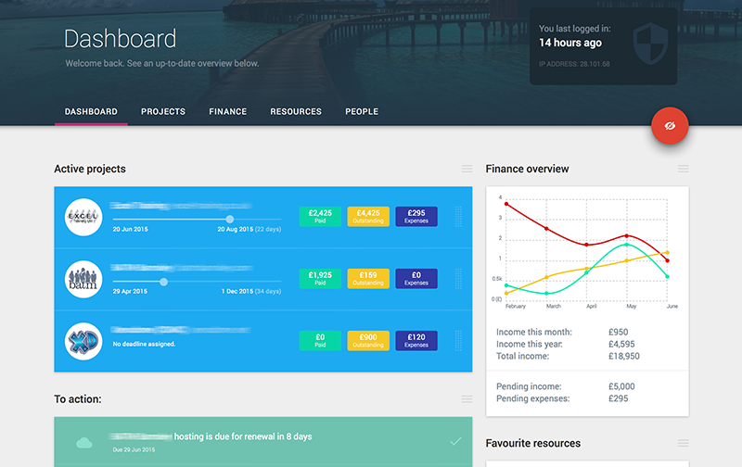
CONTINUOUS INNOVATION IN DATA BLENDING AND VISUALIZATION FOR WORLD CLASS CAMPAIGN INSIGHTS
SPOTLIGHT: CAMPAIGN VISUALIZATION
Spotlight is a flexible, cloud based, on-demand performance reporting platform (HADOOP) that provides internal and client facing dashboards. Spotlight provides visibility into our entire campaign performance portfolio supporting any number of complex KPIs, channels and data providers, including CRM, Audience, DMP, 3rd party Attribution, Viewability, Brand Equity, and very shortly cross plan, domain level and cross device insights, at scale. Used by Automated Traders, Account Managers, Finance, Clients and Analysts.
CAMPAIGN PERFORMANCE,
VIEWABILITY & VERIFICATION
AUDIENCE ANALYSIS
PACING DELIVERY
ADVANCED ATTRIBUTION
CROSS-CHANNEL SYNERGIES
DOMAIN-LEVEL TRANSPARENCY
An analytics platform that provides a 360-degree view of your data that brings together
Page
24

Slide 25
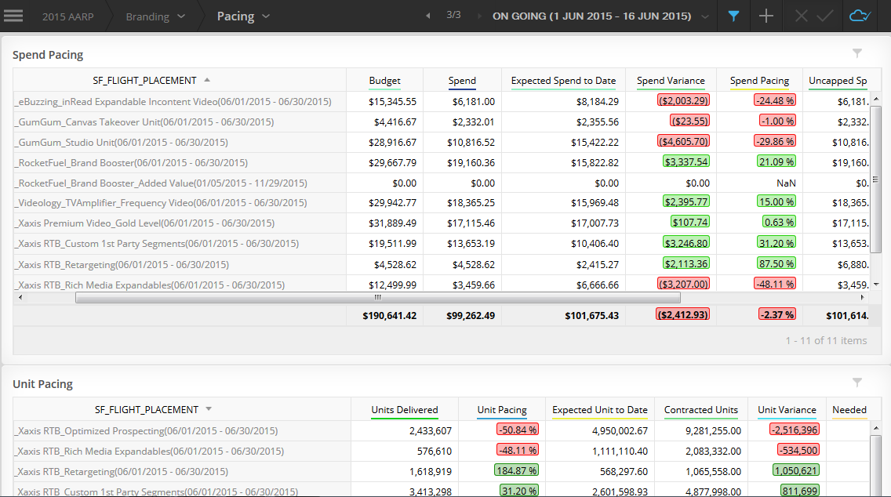
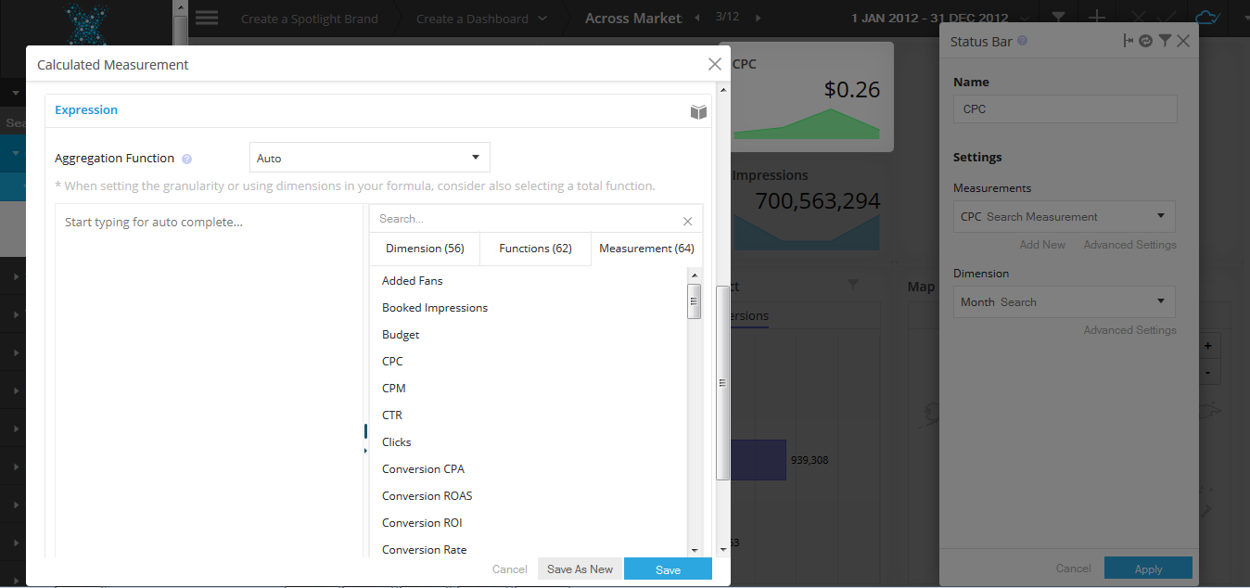
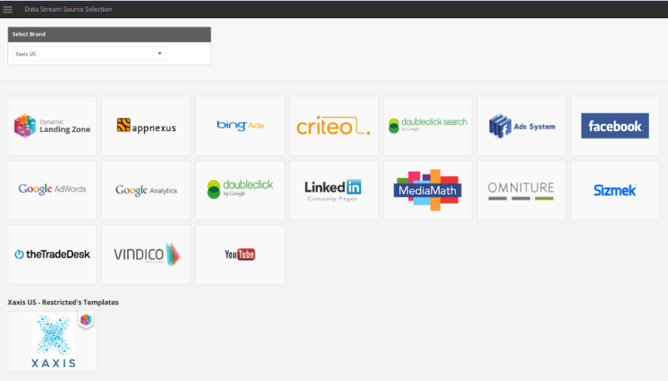
CONTINUOUS INNOVATION IN DATA BLENDING AND VISUALIZATION FOR WORLD CLASS CAMPAIGN INSIGHTS
SPOTLIGHT: UNIFIED BUSINESS INTELLIGENCE
One Login
Visual Insights
Maximum Flexibility
Full Connectivity
Page
25
Notes:
Spotlight is an analytics platform that provides a 360-degree view of your data that brings together:
Campaign performance
Pacing & delivery
Audience analysis
Advanced attribution
Cross-channel synergies
Viewability & verification
Domain-level transparency

Slide 26

XAXIS PREMIUM INVENTORY
PROGRAMMATICALLY CONNECTS BRANDS AND CUSTOMERS WHEREVER THEY ARE
Confidential and proprietary. Copyright © 2016 Xaxis Incorporation. All rights reserved. Distribution without permission is prohibited.

Slide 27

A MEDIA-AGNOSTIC APPROACH, WITH CPMS AT OR BELOW INDUSTRY BENCHMARKS
5 ADVANTAGES OF USING XAXIS PREMIUM INVENTORY
PRICE EFFICIENCY
UNIFIED AUDIENCE
ATTRIBUTION & OVERLAP
EFFICIENCY
CROSS-CHANNEL
Best in class pricing with benefits of DMP and analysis included
Insight into audience reach across an entire plan and the ability to manage partners programmatically
Analyze media effectiveness of all partners in market
By consolidating partners under Xaxis, we will handle the heavy lifting – RFPs, Proposals, Tagging, Optimization, etc
Xaxis can leverage audience data and insights across all media channels
Page
27

Slide 28
INTEGRAL AD SCIENCE
MOAT
INTEGRAL AD SCIENCE
XAXIS BRAND SAFETY LEVEL AGAINST BENCHMARKS
XAXIS VIEWABILITY LEVEL AGAINST BENCHMARKS
XAXIS FRAUD LEVEL AGAINST BENCHMARKS
Xaxis vs. Integral Ad Science
DISPLAY INVENTORY
Xaxis vs. Integral Ad Science
When compare Xaxis inventory with 2015 industry benchmarks concluded by the market leading provider, Integral Ad Science (IAS) for the entire calendar year of 2015. We had excellent results.
When compare Xaxis inventory with 2015 industry benchmarks concluded by the market leading provider, Integral Ad Science (IAS) for the entire calendar year of 2015. We had excellent results.
15% HIGHER
40% HIGHER
58%
27%
BRAND SAFETY 2015
FRAUD 2015
Xaxis inventory achieved a 4% annual decrease in brand unsafe impressions compared to 2014. This is 82% better than the Integral benchmark of 14%
Xaxis Inventory achieved a 9 percent annual decrease in fraudulent impressions compared to 2014. This is 100% better than the Integral benchmark of 10.9%
MRC
VIEWABILITY STANDARD
GROUPM VIEWABILITY STANDARD
82% BETTER THAN BENCHMARK
Xaxis has 15% higher MRC viewabilty than MOAT standard
Xaxis has 40% higher GroupM viewability than MOAT Standard
100% BETTER THAN BENCHMARK
14%
VIDEO INVENTORY
10.9%
19% HIGHER
6% HIGHER
FRAUDULENT IMPRESSIONS
BRAND UNSAFE IMPRESSIONS
52%
50%
9% DECREASE
YOY (2015-2014)
4% DECREASE
YOY (2015-2014)
MRC
VIEWABILITY STANDARD
GROUPM VIEWABILITY STANDARD
IAS STANDARD
XAXIS
Xaxis has 19% higher MRC viewabilty than MOAT standard
Xaxis has 6% higher GroupM viewability than MOAT
Standard
IAS STANDARD
XAXIS
Page
28

Slide 29
THE PROGRAMMATIC AUDIENCE COMPANY
DATA + MEDIA SCALE + TECHNOLOGY + EXPERT-TO-EXPERT SERVICES
THE XAXIS ADVANTAGE
Confidential and proprietary. Copyright © 2016 Xaxis Incorporation. All rights reserved. Distribution without permission is prohibited.

Slide 30

ONE CONSOLIDATED COST FOR ALL SERVICES AND INSIGHTS
COST-INCLUSIVE FOR THE COMPLETE PROGRAMMATIC MARKETING ADVANTAGE
TECHNOLOGY
AD VERIFICATION
All inclusive of custom audience development, data storage, & optimization
All viewability, fraud detection and brand safety reporting
DATA
ANALYTICS
All third party and second party data use and enhancements
Campaign data collection at cookie and impression levels and also data interpretations and insights
MEDIA
IN-MARKET STAFFING
CAMPAIGN
PRICING
Includes all media costs, tagging, and ad server integration
All expert-to-expert campaign level services sitting in the market

Slide 31










DATA
PROPRIETARY
BILLIONS OF DATA POINTS THAT ARE
EXCLUSIVE, AGNOSTIC, ENCOMPASSING,
UNIVERSALLY EXECUTABLE, AND
UNIFORMED

Slide 32
PROPRIETARY DATA LAYER
Level 1 Sophistication
Level 2 Sophistication
Level 3 Sophistication
Geo
Ad Slot
Device
Human/Non Human
Viewability
Brand Safety
Inventory Type
Best In-Class 3rd Party Enrichment
Device / Cookie ID
XPID
Modeling Engine
1000 + Behavioral Attributes
Inventory Supplier
Time of Day
OS
Private Marketplace
Basic Pre-Impression
Attributes
Customized Inventory
Curation
Proprietary, Closed System Data Layer Synced Optimization Engine
Page
32

Slide 33

ACCESS
PROPRIETARY
NOT ABOUT HOW MUCH DATA YOU HAVE, IT MATTERS WHEN IT EQUIPS THE BUY. IT’S WHAT YOU DO WITH THE DATA. THEN, ACCESS IS THE NEXT COMPETITIVE ADVANTAGE.
PREMIUM ADDRESSABLE MEDIA
EXCLUSIVE AUDIENCES,
EXCLUSIVE CAMPAIGNS
PROGRAMMATIC
ACTIVATION EXPERTS

Slide 34

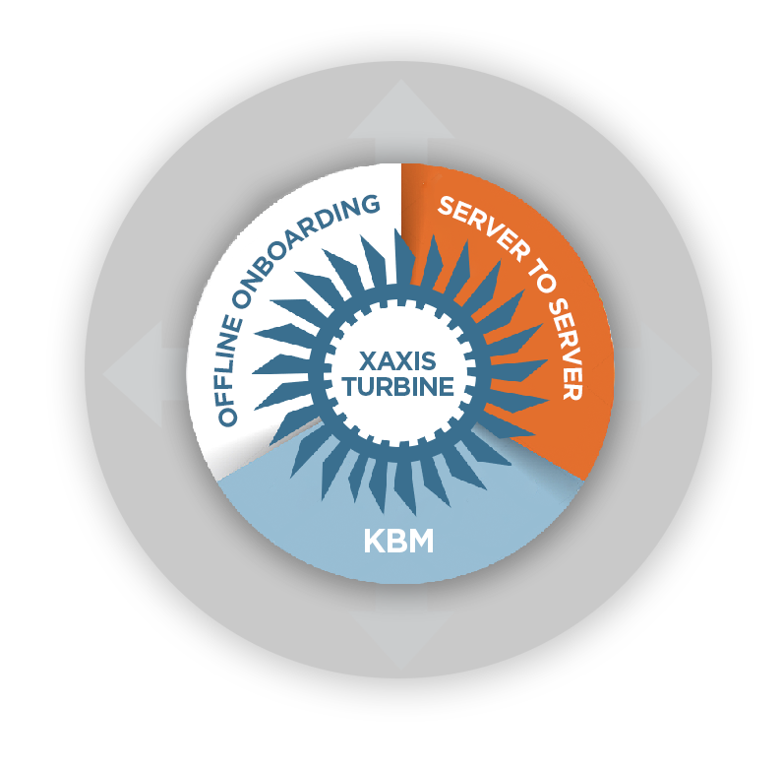


Slide 35

THE ROAD TO PROGRAMMATIC MARKETING SUCCESS STARTS HERE
XAXIS
THE PROGRAMMATIC AUDIENCE COMPANY
Confidential and proprietary. Copyright © 2016 Xaxis Incorporation. All rights reserved. Distribution without permission is prohibited.
Notes:
All about data and activation of that data.

